Slide 1
CS 4310: Software Engineering
Lecture 4
System Modeling
The Analysis Stage

Slide 2
System Models
Abstract descriptions of a system, who’s requirements are being analysed

Slide 3
Objectives of Modeling
System modelling helps the analyst to understand the functionality of the system
Different models present the system from different perspectives
  External perspective showing the system’s context or environment
  Functional perspective showing the functions of the system
  Structural perspective showing the system or data architecture

Slide 4
Model Weaknesses
They do not model non-functional system requirements
They do not usually include information about whether a method is appropriate for a given problem
They may produce too much documentation
The system models are sometimes too detailed and difficult for users to understand

Slide 5
Systems Analysis
Methods for data modeling and design
• Entity-relation diagrams
Data flow diagrams
• Data dictionaries
• Object models
Many of these methods blur the distinction between analysis and design.

Slide 6
Model Types
Data processing model showing how the data is processed at different stages
Composition model showing how entities are composed of other entities
Architectural model showing principal sub-systems
Classification model showing how entities have common characteristics
Response model showing the system’s reaction to events

Slide 7
Context Models
Context models are used to illustrate the boundaries of a system
Concerns may affect the decision on where to position system boundaries
Architectural models show the a system and its relationship with other systems

Slide 8
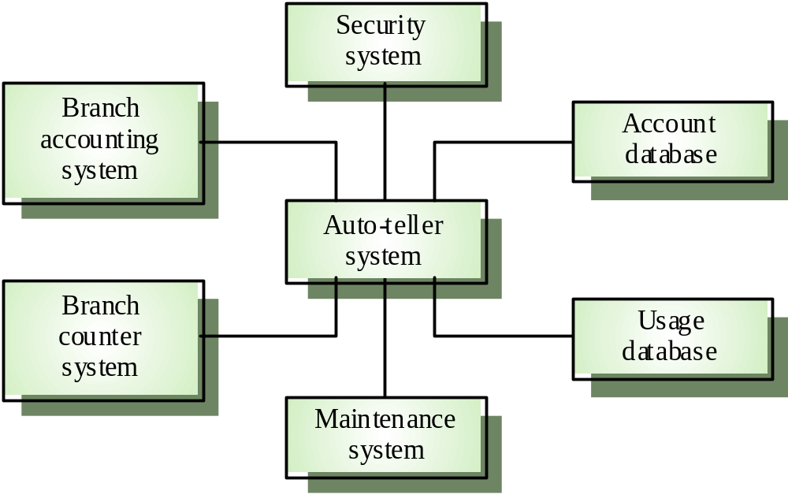
The Context of an ATM System

Slide 9
Process Models
Process models show the overall process and the processes that are supported by the system
Data flow models may be used to show the processes and the flow of information from one process to another

Slide 10
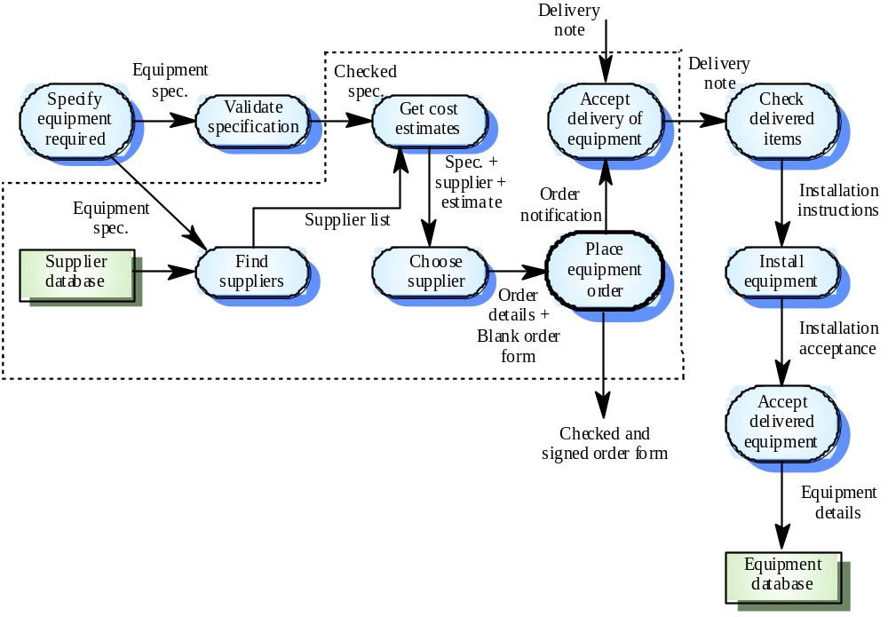
Example Process Model

Slide 11
Data Processing Models
Data flow diagrams are used to model the system’s data processing
These show the processing steps as data flows through a system
Simple and intuitive notation that customers can understand
Show end-to-end processing of data

Slide 12
Data Flow Diagram Models
DFD models the system from a functional perspective
Tracking and documenting how the data associated with a process is helpful to develop an overall understanding of the system
Data flow diagrams may also be used in showing the data exchange between a system and other systems in its environment

Slide 13
Data Dictionaries
Data dictionaries are lists of all of the names used in the system models. Descriptions of the entities, relationships and attributes are also included

Slide 14
Data Dictionaries
A data dictionary is a list of names used by the system
• Brief definition (e.g., what is "date")
• What is it (e.g., number, relation)
• Where is it used (e.g., source, used by, etc.)
• May be combined with a glossary
As the system is implemented, the data dictionary in the requirements is input to the system data dictionary, which is a formal part of the system specification.

Slide 15
Object Models
Object models describe the system in terms of object classes
An object class is an abstraction over a set of objects with common attributes and the services (operations) provided by each object
Various object models may be produced such as
  Inheritance models
  Interaction models

Slide 16
Object Models …
Natural ways of reflecting the real-world entities manipulated by the system
More abstract entities are more difficult to model using this approach
Object class identification is recognized as a difficult process requiring a deep understanding of the application domain

Slide 17
Object Models …
Structure the system into a set of loosely coupled objects with well-defined interfaces
Object-oriented decomposition is concerned with identifying object classes, their attributes and operations
When implemented, objects are created from these classes and some control model used to coordinate object operations

Slide 18
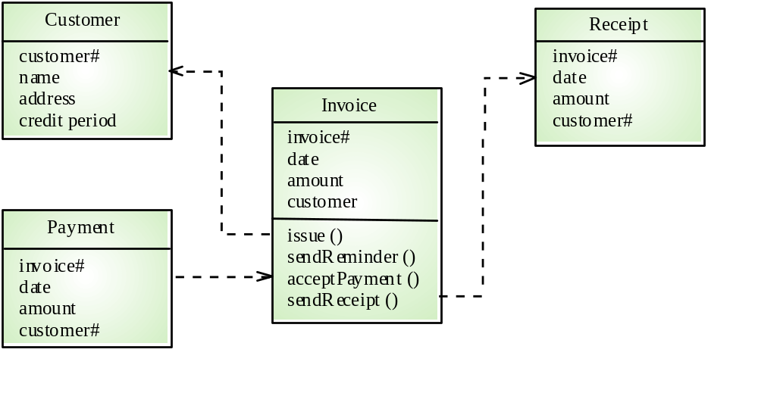
Object Model Example

Slide 19
Entity-Relation Model
• A database or system of entities and relations
• Tools for displaying and manipulating entity-relation diagrams
• Tools for manipulating a database or data storage system

Slide 20
Entity-Relation Diagram
An entity
A relation between entities
An entity or relation attribute
An inheritance relation

Slide 21
Example ERD
Book
Author of
Editor of
Creator
Describes
Catalog record
Subject heading
Is about
Short title
Control numb

Slide 22
Importance of Modeling
• A model is a simplification of reality.
• We build models so that we can better understand the system we are developing.
• We build models of complex system because we cannot comprehend such a system in its entirety.
Models can be informal or formal. The more complex the project the more valuable a formal model becomes.

Slide 23
Importance of Modeling …
• The choice of what models to create has an influence on how a problem is attacked and how a solution is shaped.
• Every model can be expressed at different levels of precision.
• The best models are connected to reality.
• No single model is sufficient. Every nontrivial system is best approached through a small set of nearly independent models.

Slide 24
Project Work
Each team needs to submit a project topic. A short description of what you are going to build.
First Project Deliverable: Requirements Document
  A print out of your document submitted in class

